Slide 1

Prof.V.B.Shah Institute of Management & R.V.Patel College of Commerce (Eng.Med.) & V.L.Shah College of Commerce (Guj.Med.) &
Sutex Bank College of Computer Applications & Science, Amroli
(Accredited ‘B’ (CGPA 2.55) by NAAC Dec.-2009)
VEER NARMAD SOUTH GUJARAT UNIVERSITY, SURAT
Minor-PROJECT REPORT
FOR THE DEGREE OF
Bachelor of computer application
(B.C.A 5TH SEMESTER)
YEAR: 2024-25
GUIDED BY:
Ms. Sanskruti Ramani
Sky Gym
(Gym Management System)
SUBMITTED BY:
Avadh Radadiya

Slide 2
SkyGYm

Slide 3

Project Profile
Project Overview
Diagrams
Screen Shots
Future Enhancements

Slide 4
Project Title | Gym Management System
Front-End: | HTML,CSS,BOOTSTRAP
Back-End: | PHP
Browser: | Chrome,FireFox
Platform : | VS Code,Xampp
Developed By : | Avadh,Nihal,Jenish,Ayush,Meet
Internal Guide : | Ms. Sanskruti Ramani
Submitted to : | Ms. Sanskruti Ramani

Slide 5

GYm Management System Gives Us To Show And pay ment Online.
This System Aims To Provide A User-Friendly Interface For Users To join Gym, Manage, And Track Their recodes While Allowing Administrators To Oversee And Control The user Efficiently.
User can easily request for a membership no need for extra knowledge regarding the join gym
This System Has Contained Two Panels:-
Admin Panel
User Panel

Slide 6
Project Features : Admin Panel
Only Authorized Admins Can Access The Panel Using Their
Registered Username And Password.
User Can Make a Payment for joining membership.
Admin Also Can add Update / Delete Slots.
Admins Can View Detailed Information About All Registered Users, Including Trainers Details, And Payment Status.
Admin Also Can Insert/Update/Delete User to trainer.

Slide 7
Project Features : User Panel
If User Have Already Have Account Then, User Can Login With Valid
User_Name And Password.
Otherwise User Can Create New Account by Register itself.
User Can able to pay to join membership.
User Also View the trainer to start the gym journey with selected trainer.
User Can Also View the photo Gallery attached by admin.
User Can Show know about us by viewing our about-us page.

Slide 8
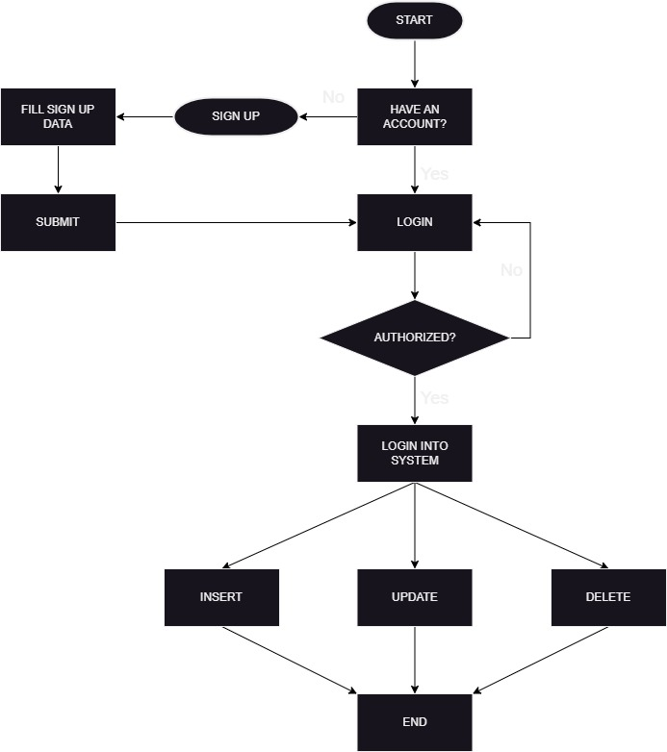
Process Diagram
Admin Process Flow-Chart

Slide 9
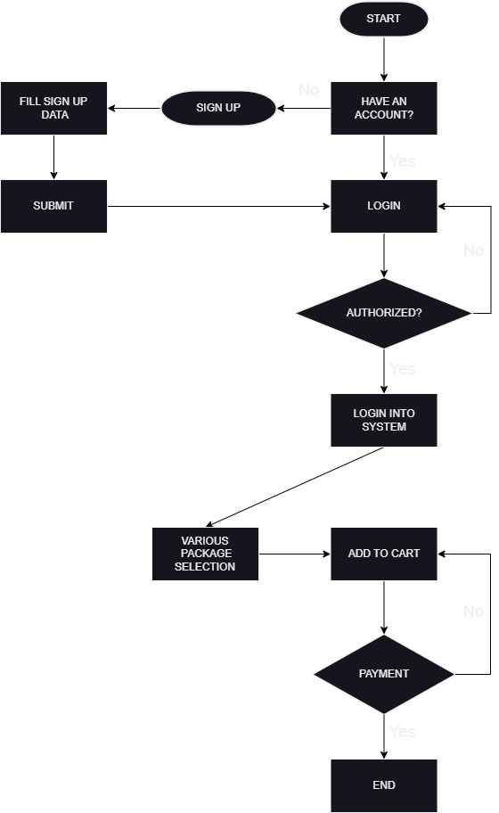
User Process Flow-Chart

Slide 10
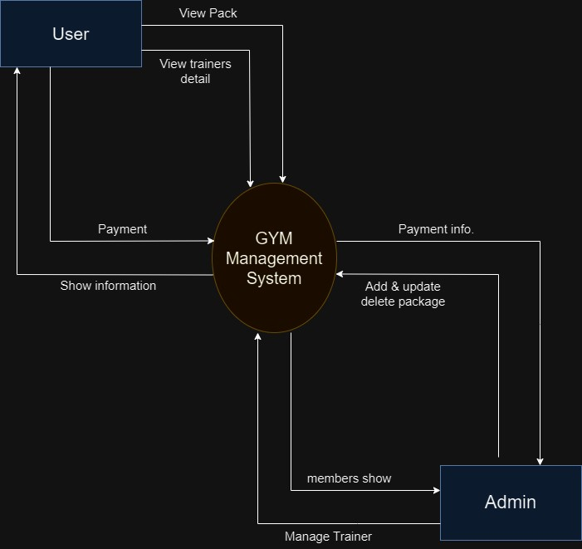
DFD / UML Diagram
0 – Level Diagram

Slide 11
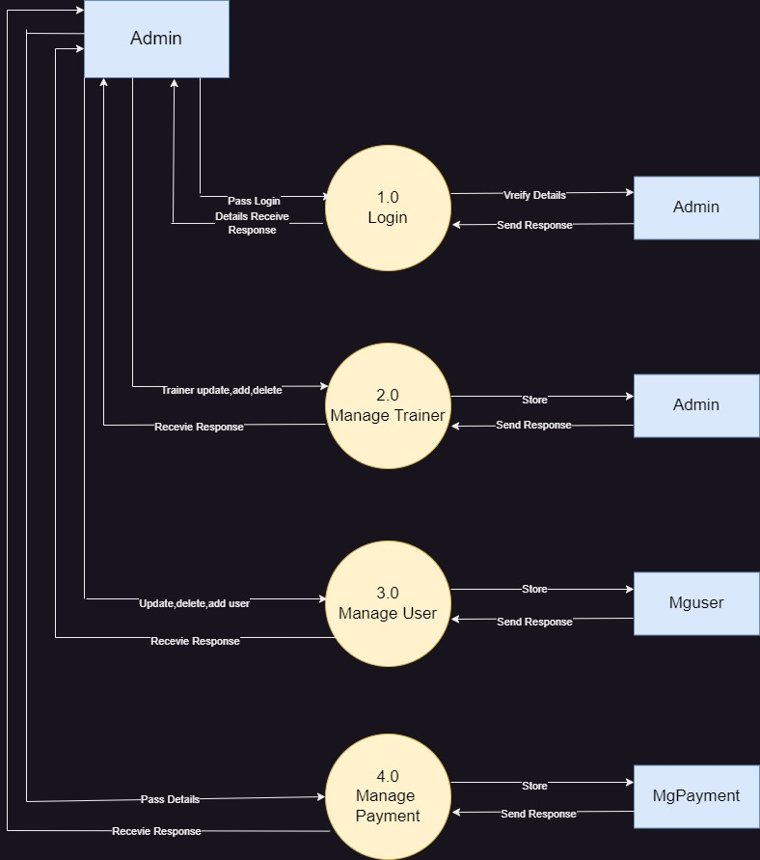
1 – Level Diagram (Admin)

Slide 12
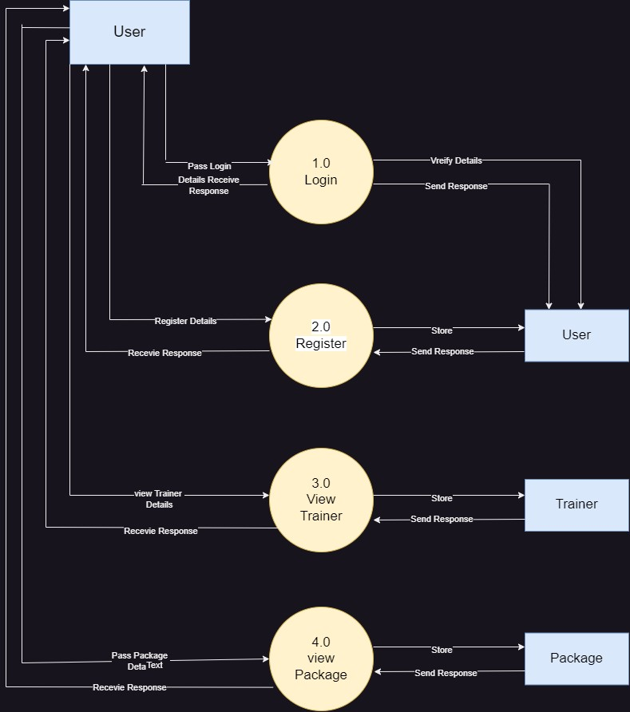
1 – Level Diagram (User)

Slide 13
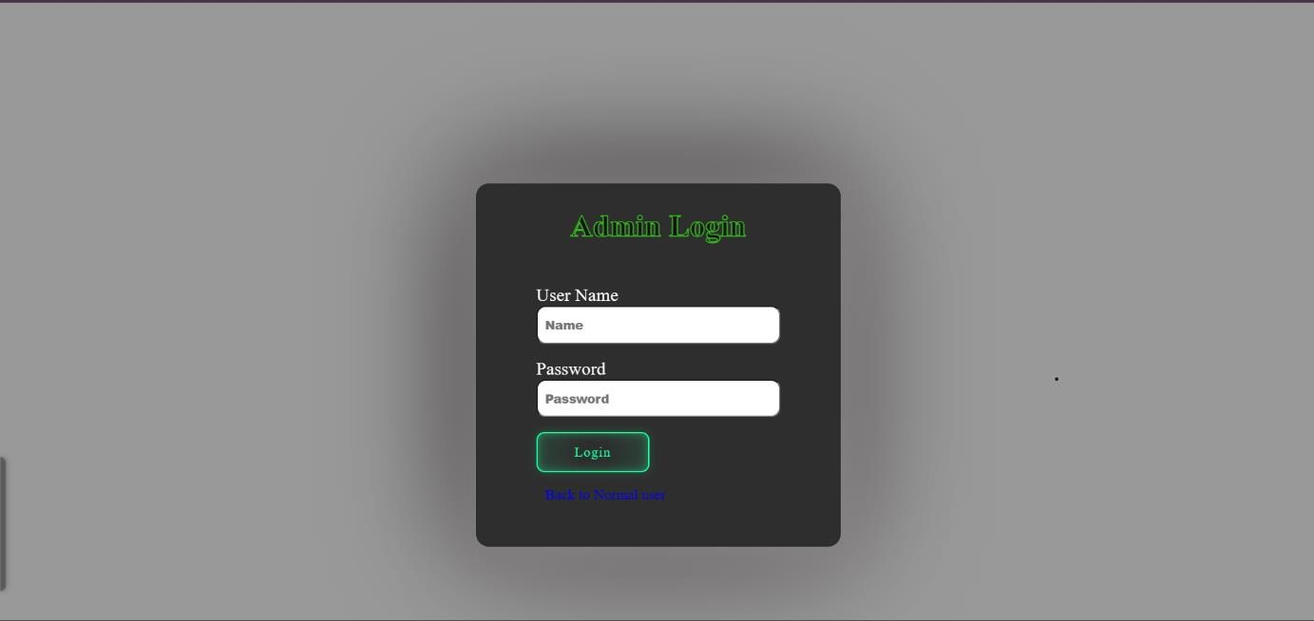
Screenshots : Admin Panel (Log In)

Slide 14
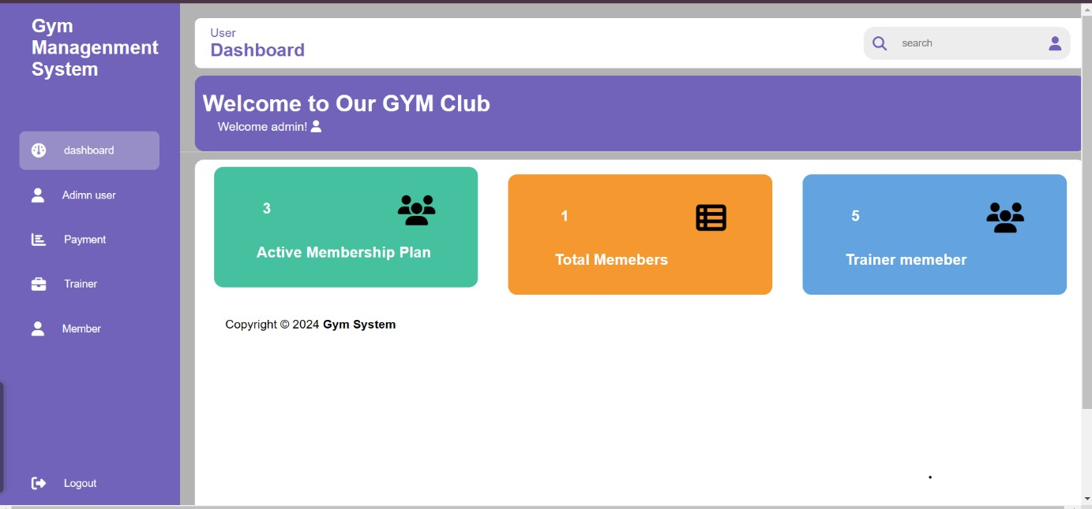
Screenshots : Admin Panel (Dashboard)

Slide 15
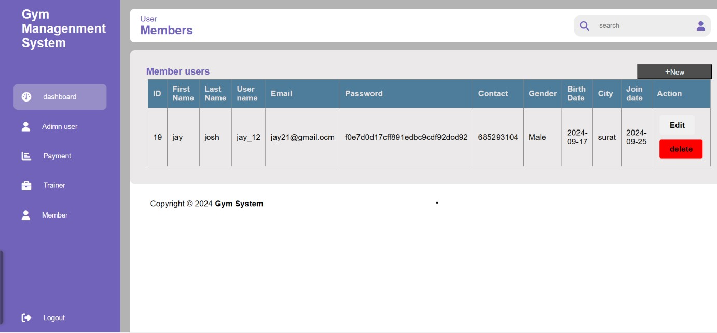
Screenshots : Admin Panel (Manage User)

Slide 16
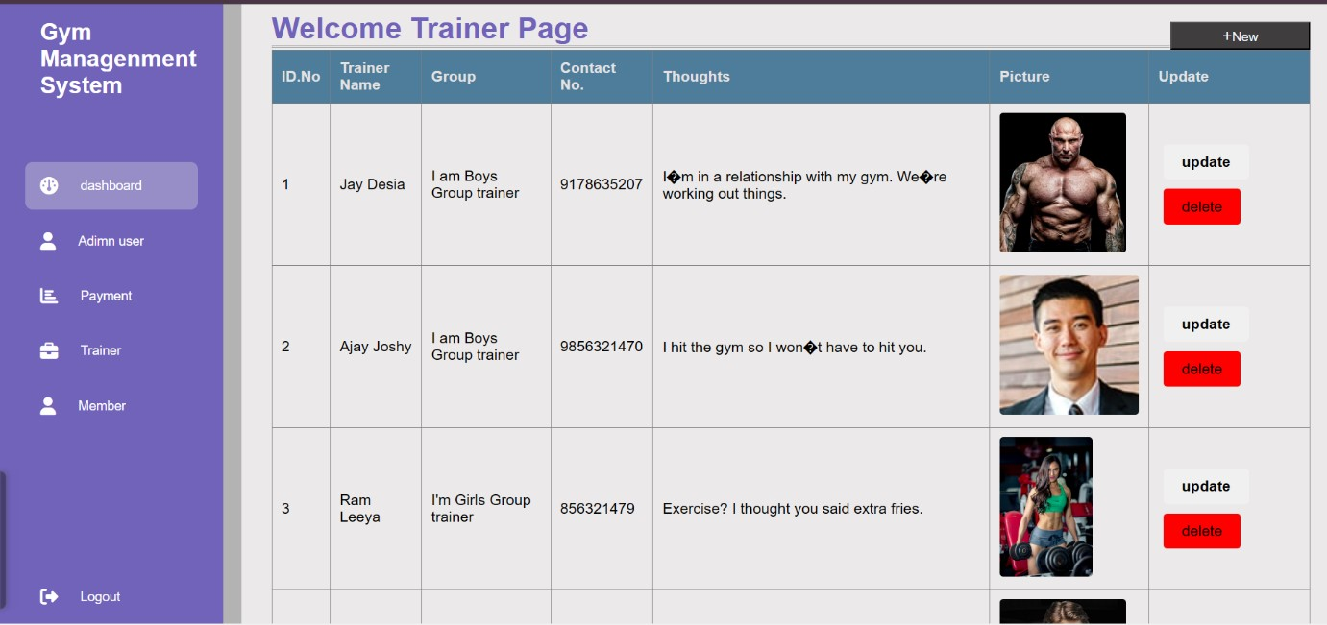
Screenshots : Admin Panel ( Manage Trainer)

Slide 17
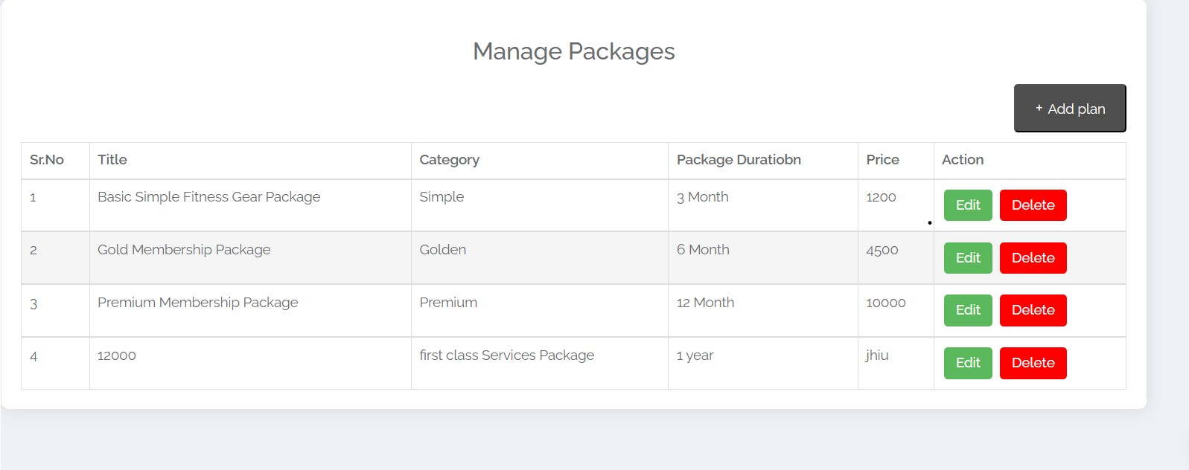
Screenshots : Admin Panel (Manage Packages)

Slide 18
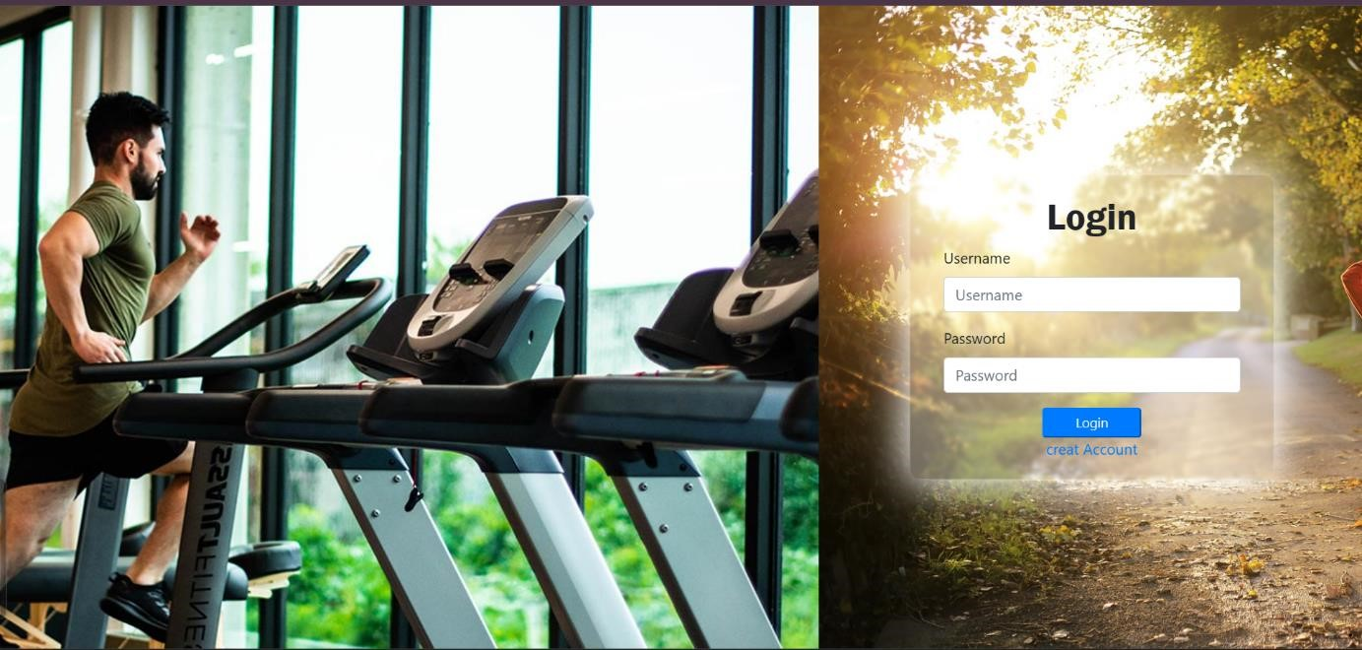
Screenshots : User Panel (Log In & Registration)

Slide 19
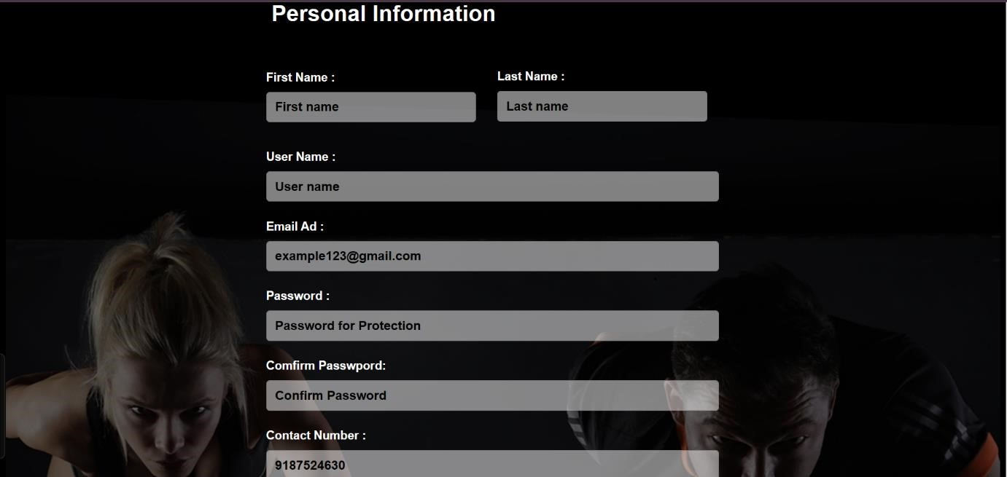
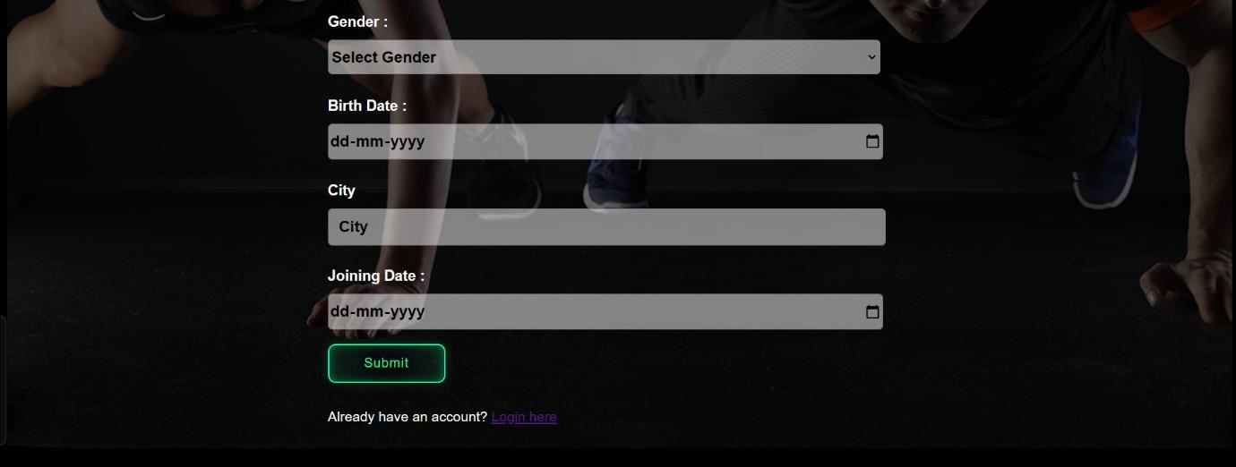

Slide 20
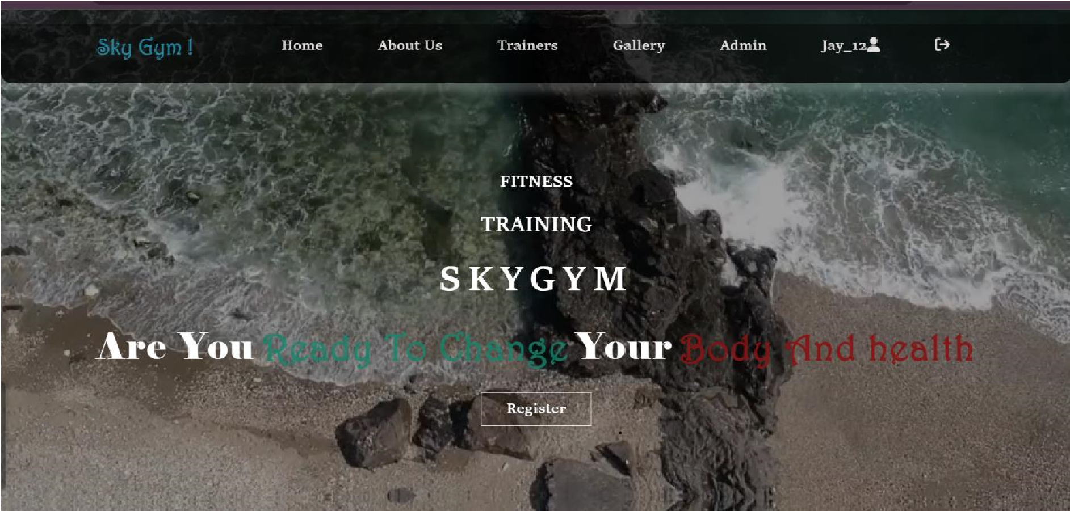
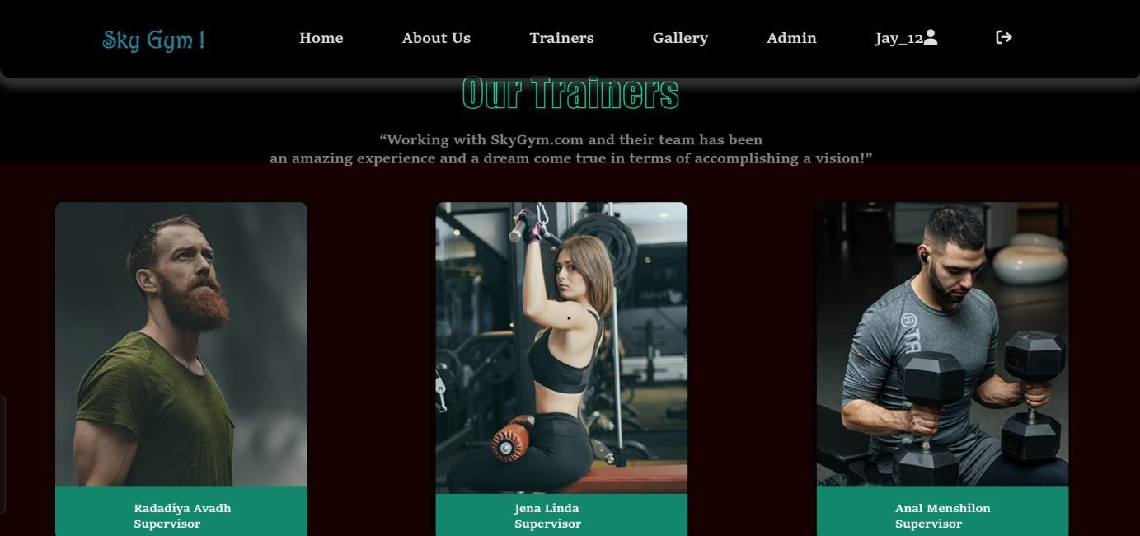
Screenshots : User Panel (Home)

Slide 21
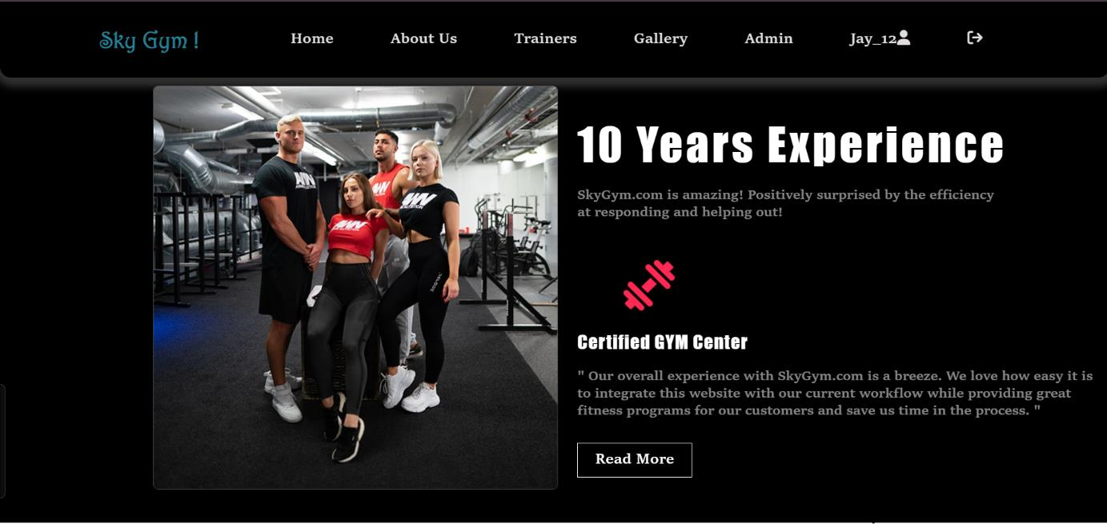
Screenshots : User Panel (About Us)

Slide 22
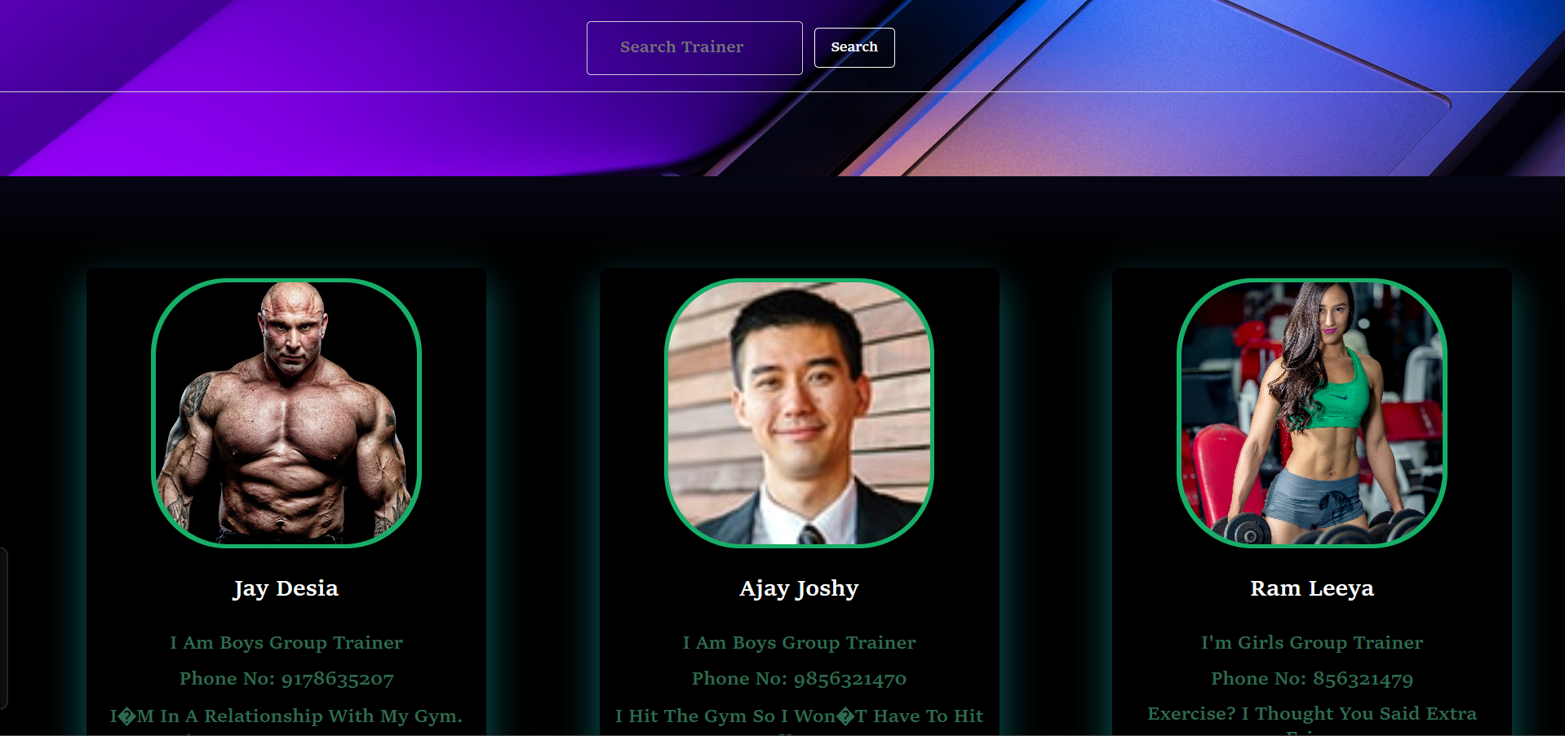
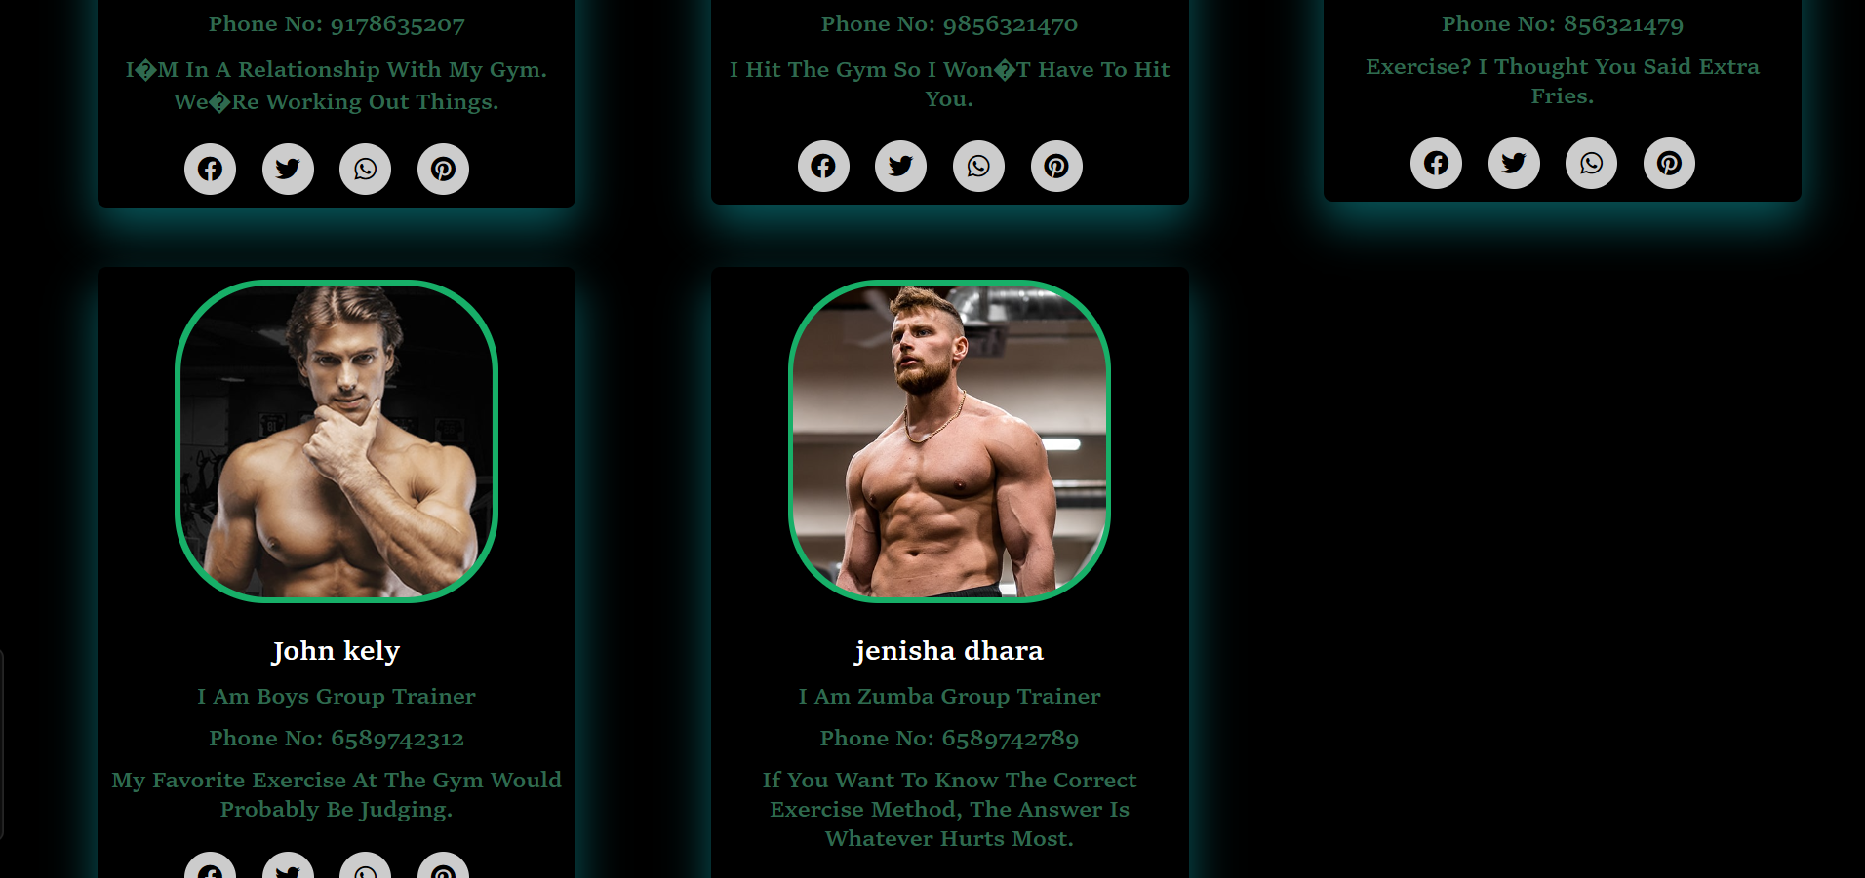
Trainer user See and Search

Slide 23
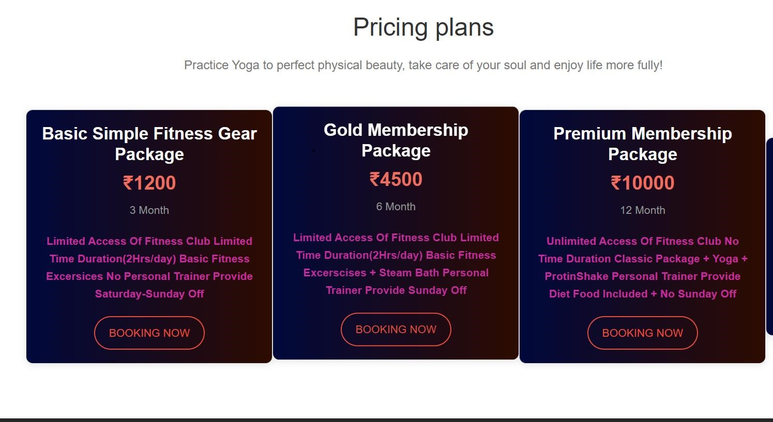
Screenshots : User Panel (Buy a Package)

Slide 24
Future Enhancement
Our Team Members Work On Responsiveness, After Sometime Our Project Is Going To Responsive.
Testing Of The Whole Project After Several Time Will Be Done. If Any Query Or Issue Raise Then Send A Message On Our Email.
Then We Will Solve It As Soon As Possible

